Slide 1


Introduction to Simulation Competitions on Kaggle
Rock, Paper, Scissors
and Hungry Geese

Slide 2
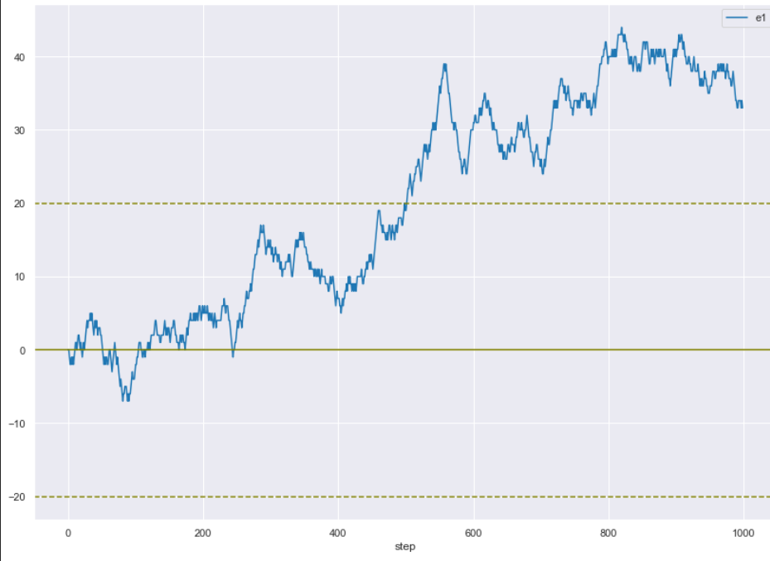
The Rock, Paper Scissors Competition
Competition Overview
You know the game!
Each turn (step) you win draw or lose
Game is best of 1000 turns (steps)
Score >= 20 you win, <= -20 you lose, otherwise you draw
Submit up to 5 agents per day
Your agents play other agents several times a day until the end of the competition
You personal score (and ranking) is the current score of your highest scoring agent
A game of 1000 steps
+20 Win
Draw
-20 Lose

Slide 3

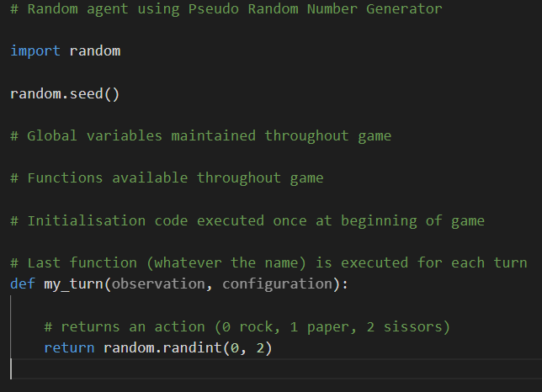
Rock Paper Scissors Competition (continued)
What is an Agent?
Your agent
Opponent agent
Your agent
Kaggle-environments

Slide 4
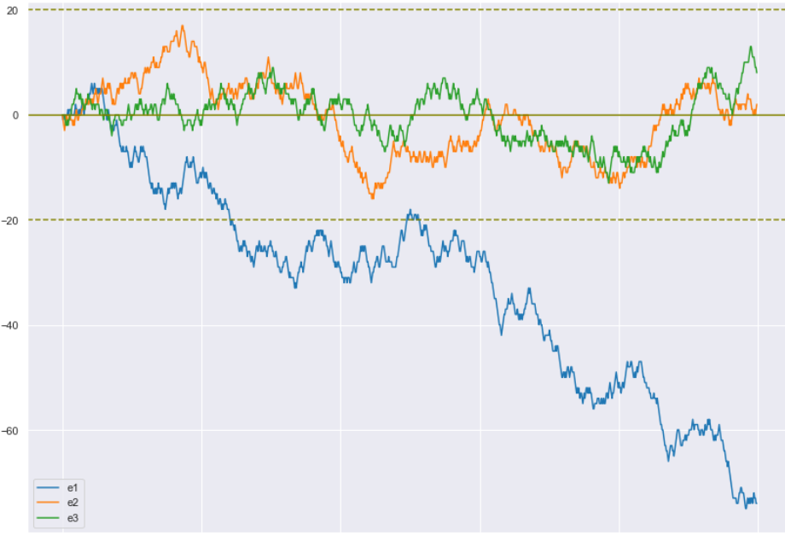
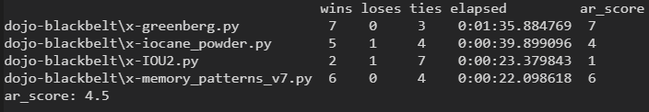
Rock Paper Scissors Competition (continued)
Testing and evaluating your agent
Is it doing what you expect?
Agent-test
Evaluating against other agents?
Dojo
Overall score

Slide 5
Rock Paper Scissors Competition (continued)
A typical approach for the RPS competition:
Use an ensemble of strong Agents to create predictions
Multi-armed Bandit Pattern Matching
Decision Tree Classifier Random Forest
Geometry etc
These are variations on:
Pattern matching
Statistical/ML predictions
Random numbers
Select your play
Your ensemble agents success in game, voting, etc
* Estimating win/loss probabilities with Dirichlet distribution (probability density function)
Considerations for selection algorithm:
Fast adoption to opponent – long memory vs short memory
Avoid exposing detectable patterns
Detecting if a known public agent is being used and then exploiting
If all failing then use random… for a while

Slide 6
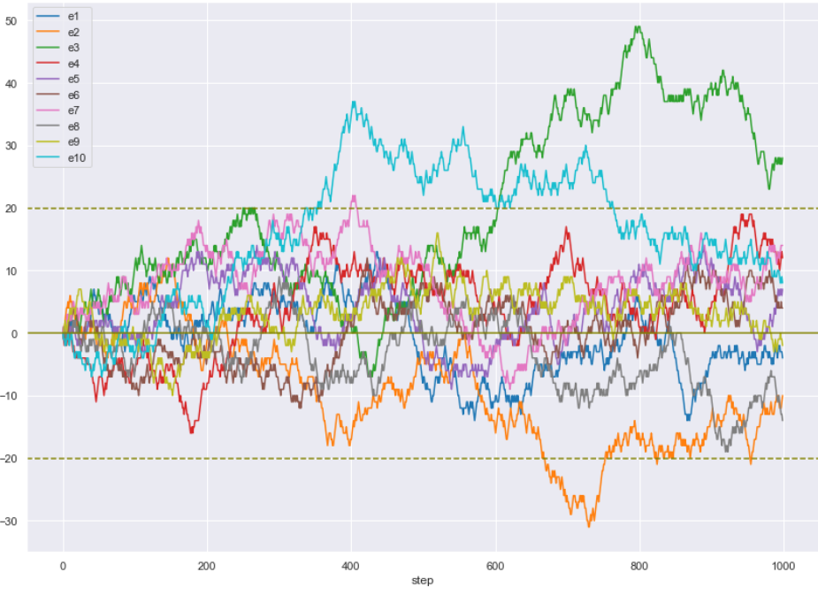
Rock Paper Scissors Competition (continued)
Some random numbers
Demo

Slide 7
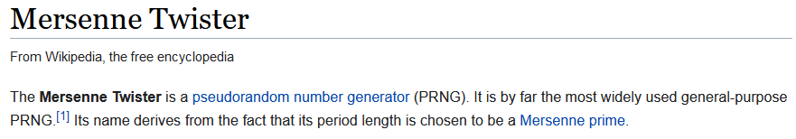
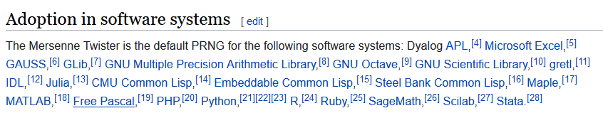
Rock Paper Scissors Competition (continued)
Some random numbers
Mersenne Twister is widely used for PRNGs as it’s:
Patent free
Passes numerous tests for statistical randomness, including the Diehard tests
Fast
Tom Liston, Random Facts About Mersenne Twisters
https://www.youtube.com/watch?v=Jo5Nlbqd-Vg

Slide 8
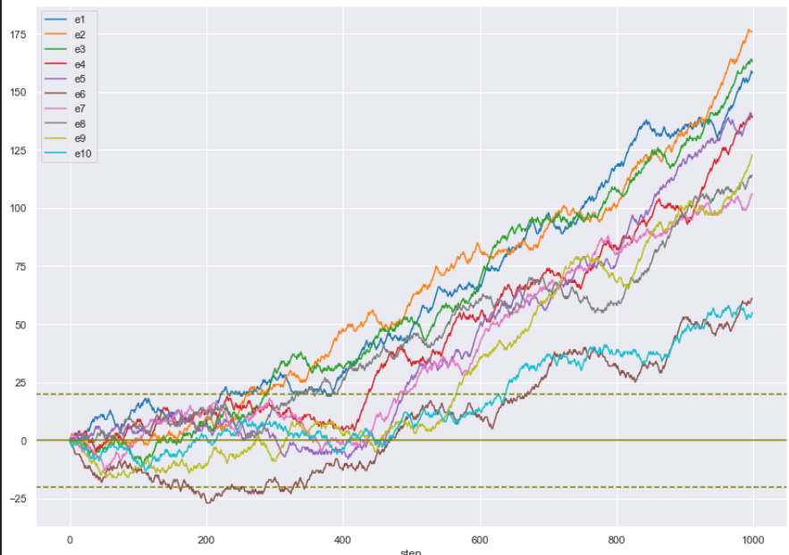
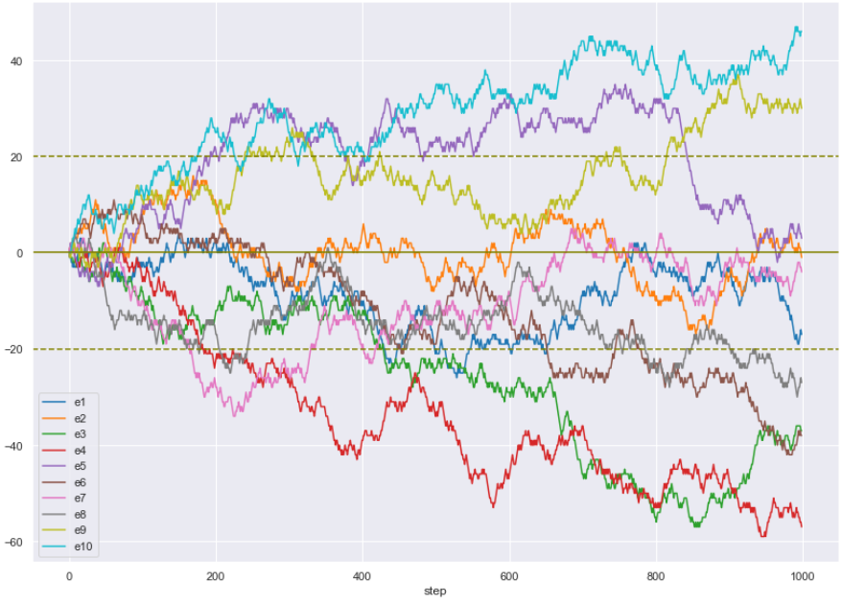
Rock Paper Scissors Competition (continued)
Some random numbers
AR-V18 agent… playing the PRNG
…playing the secrets random

Slide 9
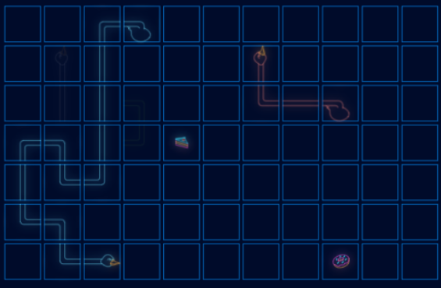
The Hungry Geese Competition
Four geese in a game on a 11 x 7 grid.
200 steps in each game.
Survive the longest number of turns by eating food to stay alive, and by not running into other segments of your or your 3 opponents.
Agents add segments to their goose by eating food. Every 40 steps the goose loses a segment.
Agent with the highest reward (steps survived then length), or the last agent remaining, wins the game.
Change in your agent’s score depends on agents placing in the game and their previous score.
Last submission 26 July 2021

Slide 10
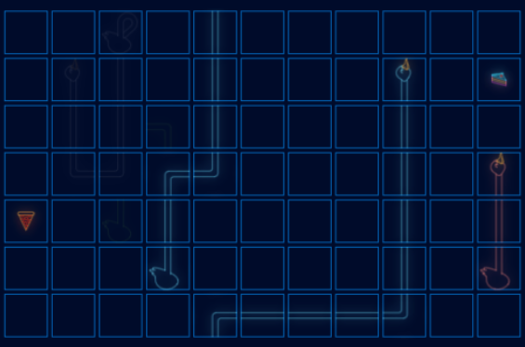
The Hungry Geese Competition (continued)
This competition has more ‘game angles’:
How do I:
Avoid being trapped by my opponents… or myself?
Trap my opponents?
Stop them from getting the food?
Make sure I get the food first?
Extensive research exists in building Snake models using reinforcement learning, Q-learning, neural networks, and more. Take your grid-based reinforcement learning knowledge to the next level with this exciting new challenge! (Kaggle)

Slide 11
The Hungry Geese Competition (continued)
Resources
Kaggle:
https://www.kaggle.com/c/hungry-geese (Run a starter kernel and submit)
https://www.kaggle.com/learn/intro-to-game-ai-and-reinforcement-learning
Kaggle-environments API: https://github.com/Kaggle/kaggle-environments
https://www.kaggle.com/ks2019/handy-rl-training-notebook
Reinforcement Learning:
https://www.youtube.com/watch?v=K67RJH3V7Yw&list=PLMsTLcO6ettgmyLVrcPvFLYi2Rs-R4JOE (Feb 2021, based on David Silver but simpler)
David Silver’s work https://www.davidsilver.uk/teaching/
Phil Wilder Reinforcement Learning: Industrial Applications of Intelligent Agents 1st Edition- Nov 2020 https://www.amazon.com/_/dp/1098114833?tag=oreilly20-20
So many resources… https://github.com/dennybritz/reinforcement-learning

Slide 12
The Hungry Geese Competition (continued)
Let’s submit an entry!!!
https://www.kaggle.com/ace147/random-dir-straight-go
First approach should be simple :
If there's food in the same row or column, take a step towards it.
Otherwise take a step in any random direction.
API resources : https://pypi.org/project/kaggle-environments/
https://github.com/Kaggle/kaggle-environments
https://www.kaggle.com/ihelon/hungry-geese-agents-comparison

